Slide 1

Multimodal LLMs for GEOINT Looking Towards the Future
November 3rd, 2025
Pedro Uria, David Siamon, Nicholas Harvey
Vibrint ML Team

Slide 2


Challenges with traditional GeoAI approaches
GeoAI typically focuses on
single-modality analysis
Actionable intelligence often requires the integration of multiple data types
GEOINT data is growing exponentially, expected to at least triple in the next 5 years

Slide 3


Multimodal Large Language Models (MLLMS)
MLLMs are advanced AI models designed to process and integrate data from multiple modalities—such as text, images, audio, and video—within a single architecture
This image depicts a ship moving […]
OUTPUTS
Popular MLLMs:
GPT-5 (OpenAI)
Gemma (Google)
Gemini (Google)
Phi-4 (Microsoft)
Llama 4 (Meta)
INPUTS

Slide 4


Remote Sensing MLLMs Capabilities
Ground Captioning
Image Captioning
Classification
Visual Question Answering
Object Detection
Change Captioning
Labels and explains what’s in each part of the image.
Gives a short description of what's happening in the whole image.
Identifies the overall type or category of a scene (like mountain or city)
It answers questions people ask about the image, like what activity is happening.
Draws boxes around objects like cars or courts to show exactly where they are.
It compares two pictures and describes what has changed between them.

Slide 5

Enhancing GEOINT workflows with MLLMs
Multi-source data fusion
Combine overhead images, social media posts, textual reports, GIS layers, etc. Incorporate situational context
Automated Imagery Triage and Object Recognition
Interactive Q&A and Analysis
Automatically detect, label, and prioritize objects or areas of interest
Go beyond bespoke object detectors by describing and contextualizing
Interactive analyst’s assistant
Capable of answering questions about geospatial data in natural language

Slide 6
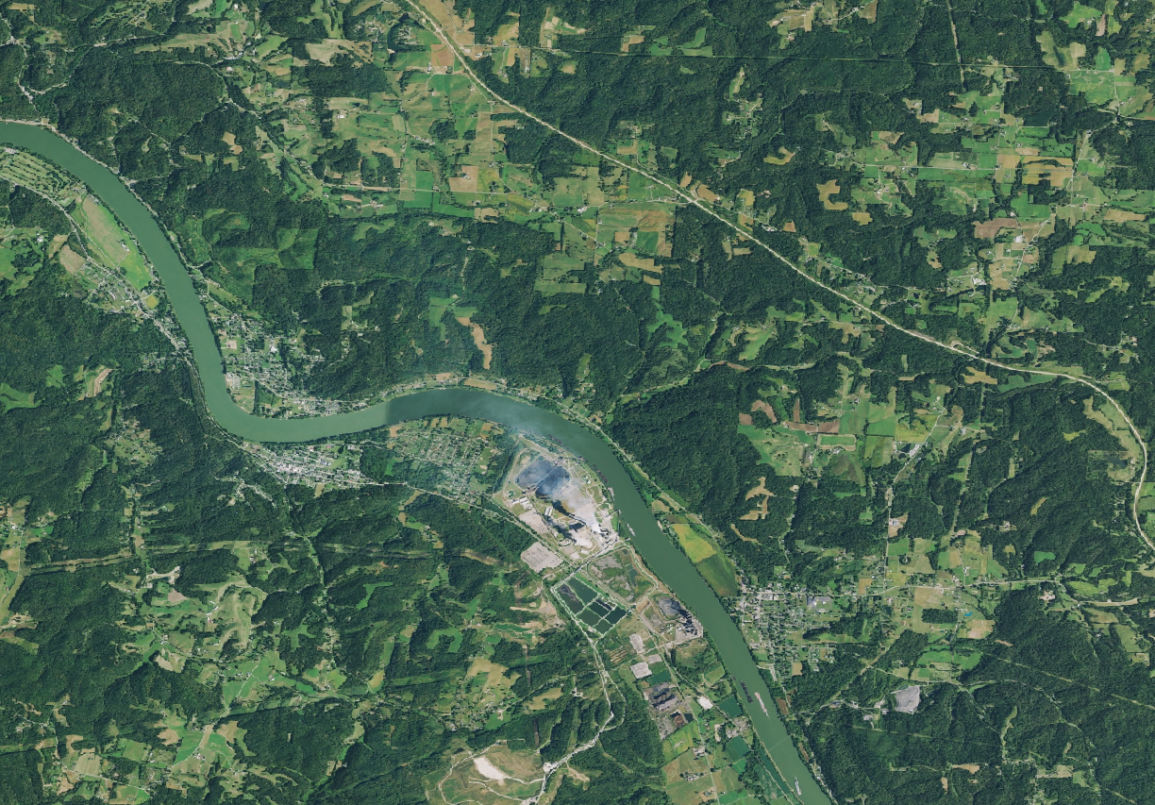
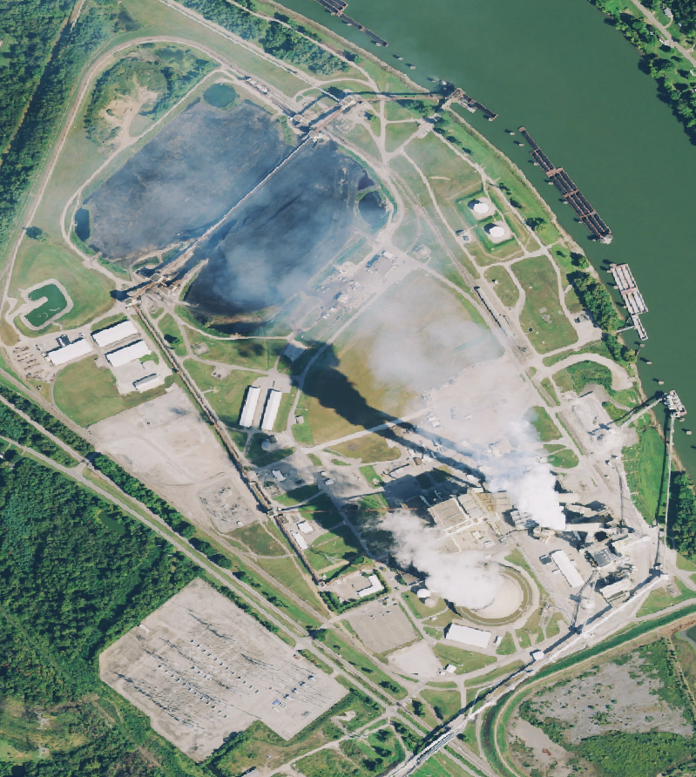

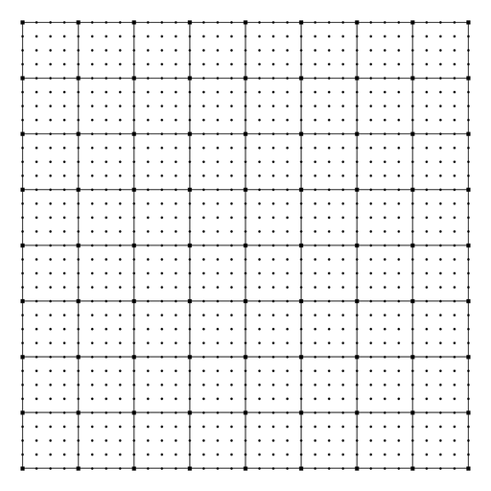


Case Study | A Multi-Tiered Image Processing Approach for Contextual Analysis with MLLMs
Layer 1: Wide-Area Search and Identification (Macro Analysis)
Identify potential power plants and tell me their locations in the image
The image shows potential power plant located near the center, adjacent to the river. It can be identified by its industrial features and infrastructure typically associated with power generation facilities.
Without specific labels, it’s challenging to determine the type of power plant, but the location along the river suggests it may rely on water for operations, potentially indicating hydroelectric, coal-fired, or gas-fired generation.
* This case study was performed with LibreGeoLens. A live demo will be given today.
+1
Send

Slide 7
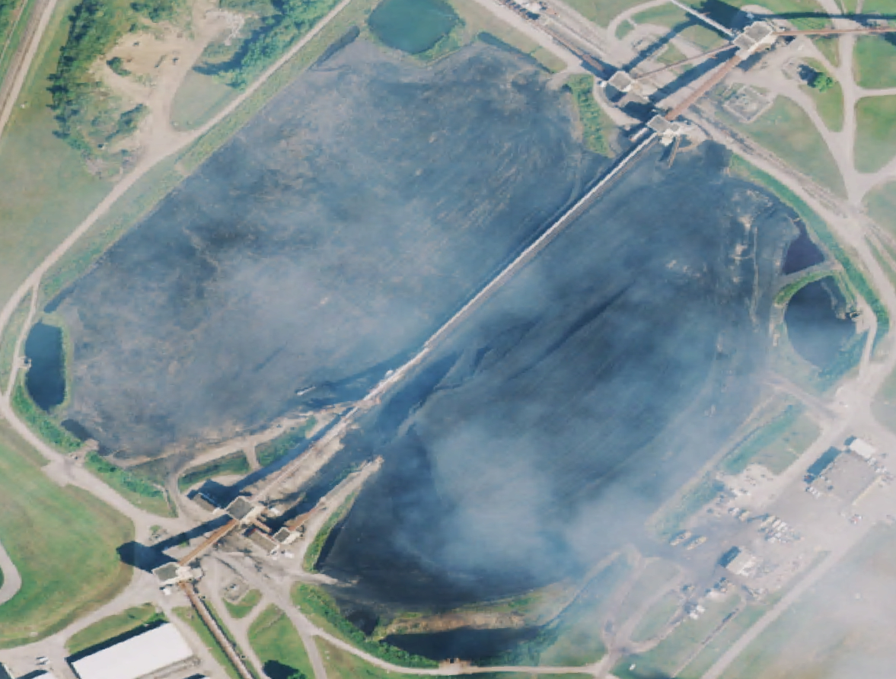
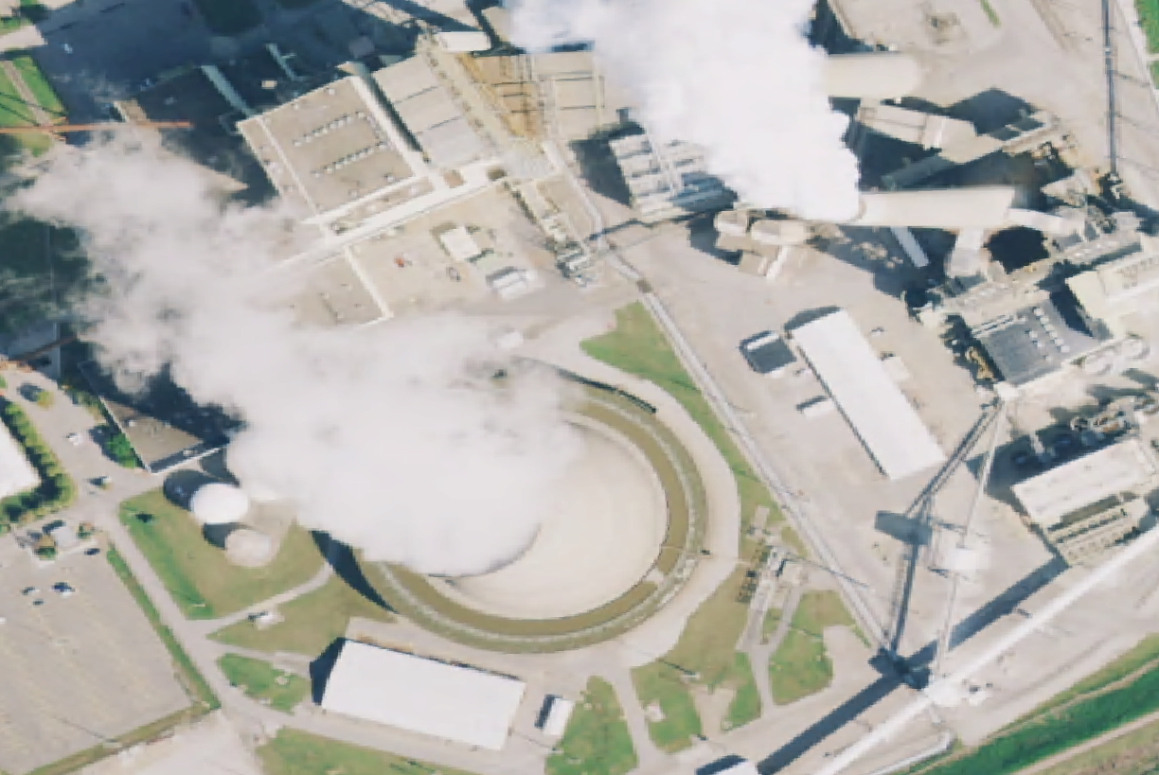
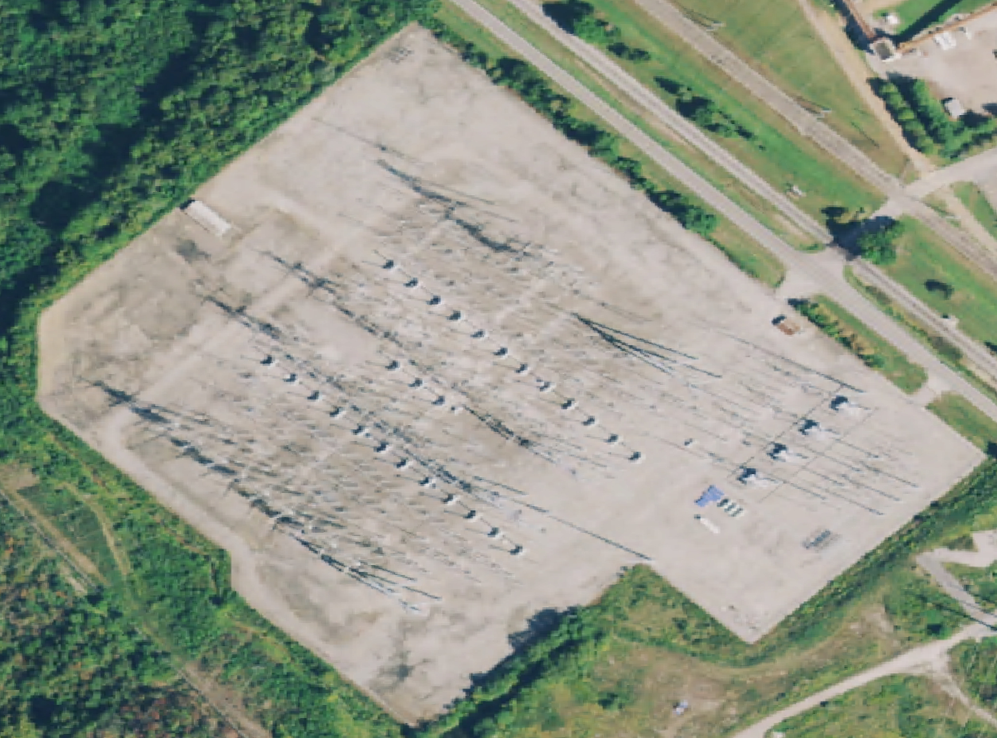
Case Study | A Multi-Tiered Image Processing Approach for Contextual Analysis with MLLMs
Layer 2: Facility-Level Delineation & Segmentation (Meso Analysis)
This is a closer look at power plant you identified in the previous image. Describe it in greater detail and adjust your previous analysis accordingly.
The closer view at the facility indicates it is likely a coal-fired power plant. Key features include:
Coal Storage: (…)
Emissions: (…)
Infrastructure: (…)
River Access: (…)
Overall, this characteristics support the identification of the facility as a coal-fired power plant.
+1
Send

Slide 8
Case Study | A Multi-Tiered Image Processing Approach for Contextual Analysis with MLLMs
Layer 3: Focused Activity Analysis (Micro Analysis)
Layer 4: Contextual Integration and Querying
These are relevant subregions that you’ve identified. Describe them in greater detail.
Taking all this context into account, can you summarize your findings about this region into a detailed report?
Taking all this context into account, can you summarize your findings about this region into a detailed report?
Certainly! Here is a detailed description of each subregion:
Coal Storage Area
(…) contains large coal piles (…) fuel for (…)
Conveyor belts run across the piles (…) transport
Electrical Substation:
(…) grid-like (…) electrical equipment.
(…) connection point for electricity generated (…)
Presence of transformers and switchgear is likely.
Main Plant Structure:
(…) cooling towers, chimneys (…) steam & smoke.
(…) heat dissipation.
(…) turbines, generators (…)
(…) core operational area of the power plant.
The region examined is a coal-fired power plant situated along a river, utilizing the water source for operational needs. (…)
Key components: (…)
Operational Insights:
River Proximity: (…)
Environmental Considerations: (…)
This analyzed region is a notable example of an operational coal-fired power plant. Its strategic riverside location and comprehensive infrastructure showcase the typical features and challenges associated with coal-based energy generation. This assessment provides a foundational understanding of the plant’s role in regional power supply and its environmental and logistical dynamics.
Send
+3
Send

Slide 9
MLLM Challenges and Limitations
Challenges
Limitations
Grounding via retrieval / prompting is essential to reduce the amount of vagueness and hallucinations
Without metadata like image resolution or location, MLLMs struggle to adapt to different environments or scenarios
Can’t ingest full-scale imagery, so external infrastructure is needed to manage context
High compute/storage costs and ongoing maintenance impact scalability and deployment
Fine-tuning with expert input might be needed for reliable performance in specialized use cases
MLLMs struggle to convey numerical confidences in their outputs

Slide 10
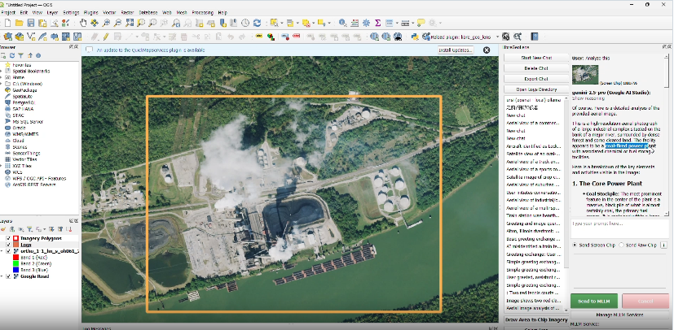



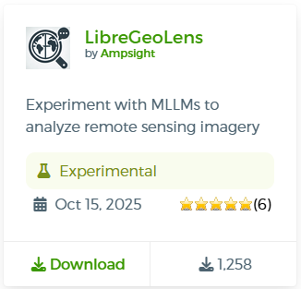

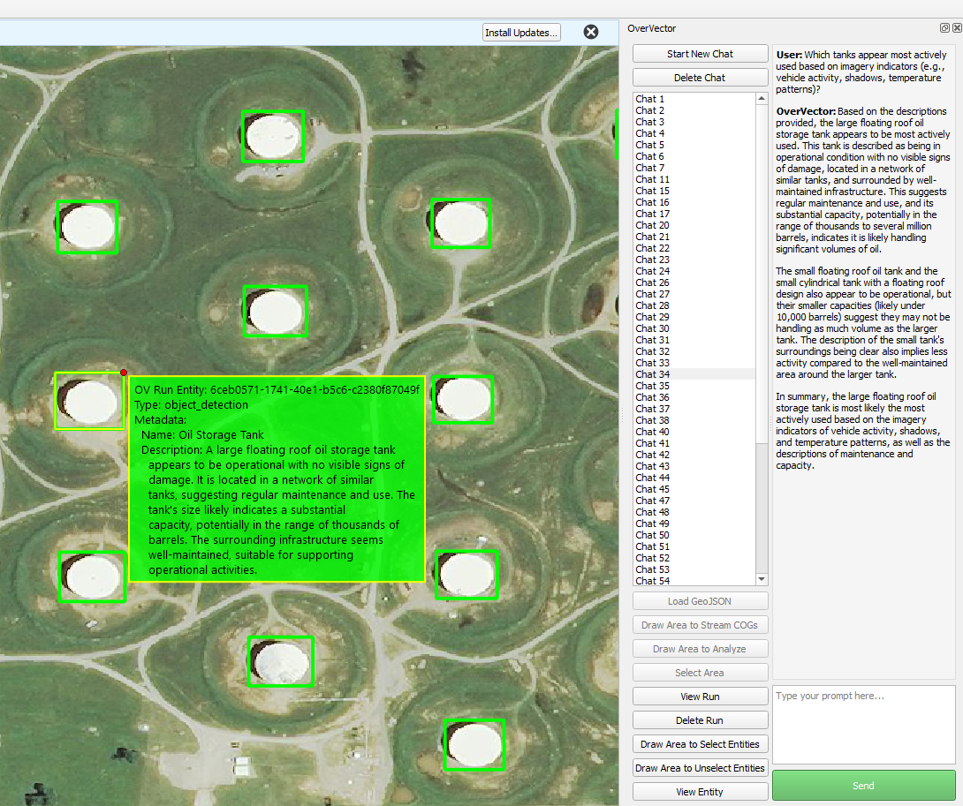

Contact Us
Open-Source
QGIS Plugin
NICK HARVEY
Data Scientist
nicholas.harvey@vibrint.com
DAVID SIAMON
AI/ML Engineer
david.siamon@vibrint.com
PEDRO URIA
Data Scientist
pedro.uria@vibrint.com
An AI assistant to help you analyze remote sensing imagery

Slide 11
Thank you

